Slide 1
Fall Detection Using Camera Feeds
In the Name of God
Mansour Saffar Mehrjardi
Mohammad Hadi Shadmehr
Mohsen Mohammadi

Slide 2
Introduction
Data Acquisition and Processing
Feature Selection and Extraction
Classification

Slide 3
Introduction

Slide 4
Why fall detection ?
Falls are a major issue among older adults.
1/3 older adults(those ages 65 or over) fall each year
Of those who fall, many suffer serious injuries
Hip fractures, head traumas
Reduces their mobility and independence
Increases risk of early death
Direct medical cost of more than $19 billion in 2000 in the US

Slide 7
Data Acquisition and Processing

Slide 8
Data Acquisition
We used webcam for data acquisition.
MATLAB data acquisition toolbox was used to acquire frames.
We took about 10 seconds recording from the subject normal walking and also his fall.
Acquired images were of size 720 in 1280 (16/9 aspect ratio) pixels and frame rate was 30 FPS.

Slide 9
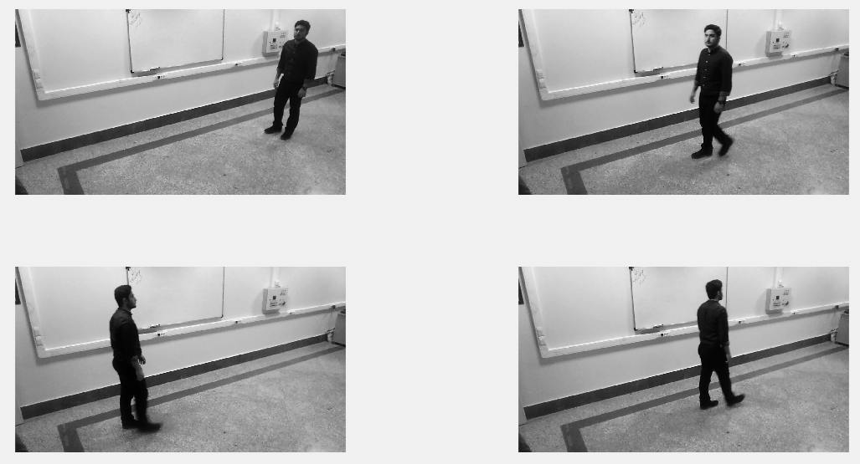
Sample of Acquired data
You can see Mohsen walking in lab ☺

Slide 10
Background Extraction
There are several methods to extract background from consequent frames.
In our project we used median method to extract background from 300 frames. We took median of each pixel value along 300 frames and assigned each pixel to its median value. The formula expression for this method is show below
MP_{x,y} = median( P_{1 x,y} , P_{2 x,y,} P_{3 x,y,..,} P_{300 x,y} )

Slide 11
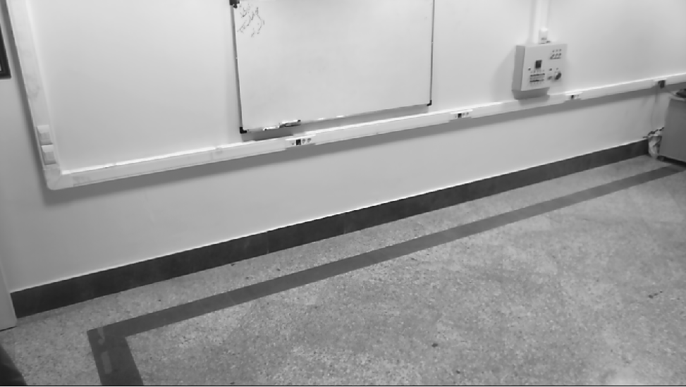
Background Extraction
Extracted background from previous data

Slide 12
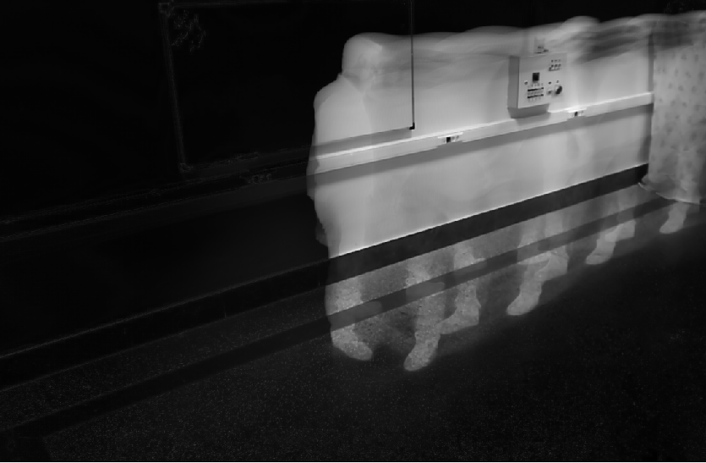
Background Extraction
Standard deviation of each pixel in 300 frames depicted as an image

Slide 13
Silhouette Extraction
In order to extract silhouette in each frame we subtracted the background from each frame and then used thresholding to extract silhouette.

Slide 14
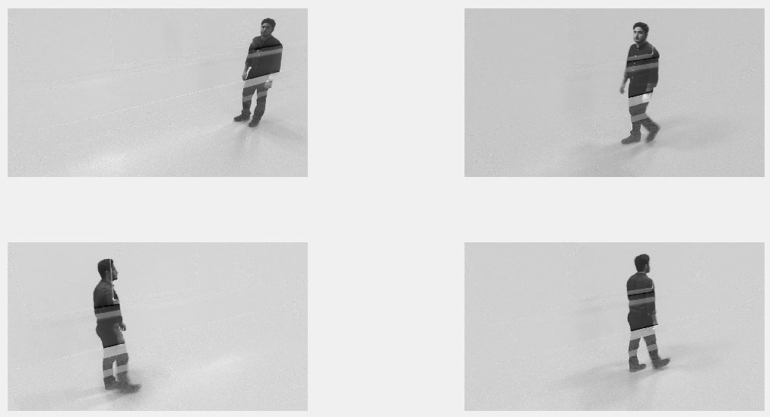
Silhouette Extraction
You can see Mohsen walking in void !! ☺

Slide 15
Silhouette Extraction
Thresholding is a method to convert grayscale image into binary image.
In our project we used thresholding to extract silhouette from frames.
The value for thresholding was chosen arbitrarily and we examined several values to get the best result possible.

Slide 16
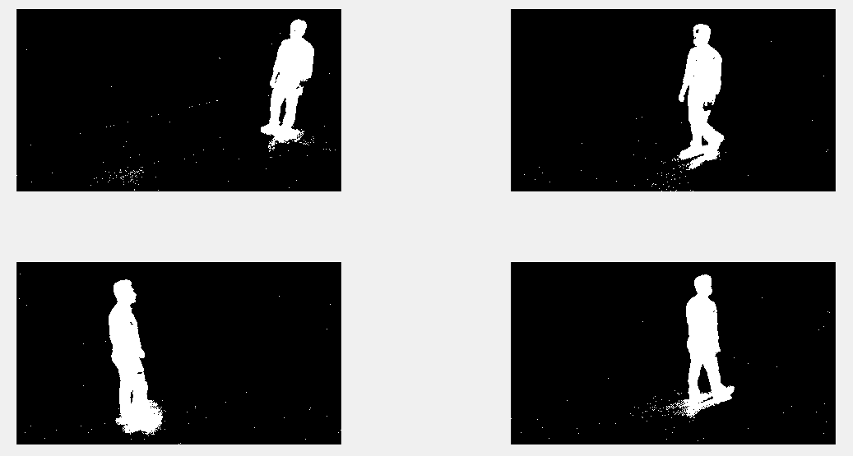
Silhouette Extraction
Threshold value set to 25

Slide 17
Silhouette Extraction
Threshold value set to 25

Slide 18
Morphological Enhancement
Morphological image processing covers a wide range of functions to manipulate the overall shape of objects in image, regardless of their pixel values.
Here we use 2 methods called “opening” and “closing” images.

Slide 19
Morphological Enhancement
In morphological image processing a structuring element is used to process the shape of image.
The number of pixel removed from boundaries of picture or added to it depends on shape and size of structuring element.
Closing means dilation followed by erosion.
Opening means erosion followed by closure.

Slide 20
Morphological Enhancement
Dilation adds pixels to boundaries of object
The value of the output pixel is the maximum value of all the pixels in the input pixel's neighborhood. In a binary image, if any of the pixels is set to the value 1, the output pixel is set to 1 (Hit rule).
Erosion removes pixels from boundaries of object
The value of the output pixel is the minimum value of all the pixels in the input pixel's neighborhood. In a binary image, if any of the pixels is set to 0, the output pixel is set to 0 (Fit rule).

Slide 21

Dilation

Slide 22

Erosion

Slide 23

Morphological Enhancement

Slide 24
Further Improvements
We don’t need exact shape of silhouette since we use features that doesn’t depend on exact shape of subject.
To avoid shadow artifacts we increase thresholding value to 40.
Although exact shape is lost and some body parts are separated BUT our feature extraction technique is independent of these artifacts.

Slide 25
Feature Selection and Extraction

Slide 26
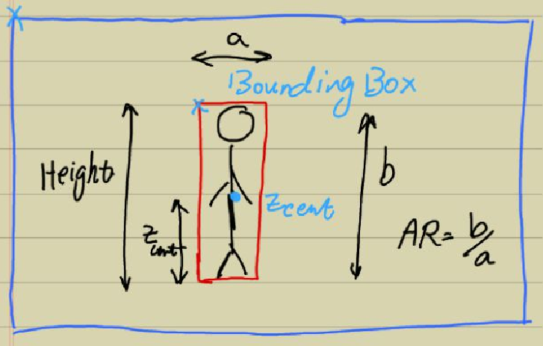
Features to Detect Fall

Slide 27
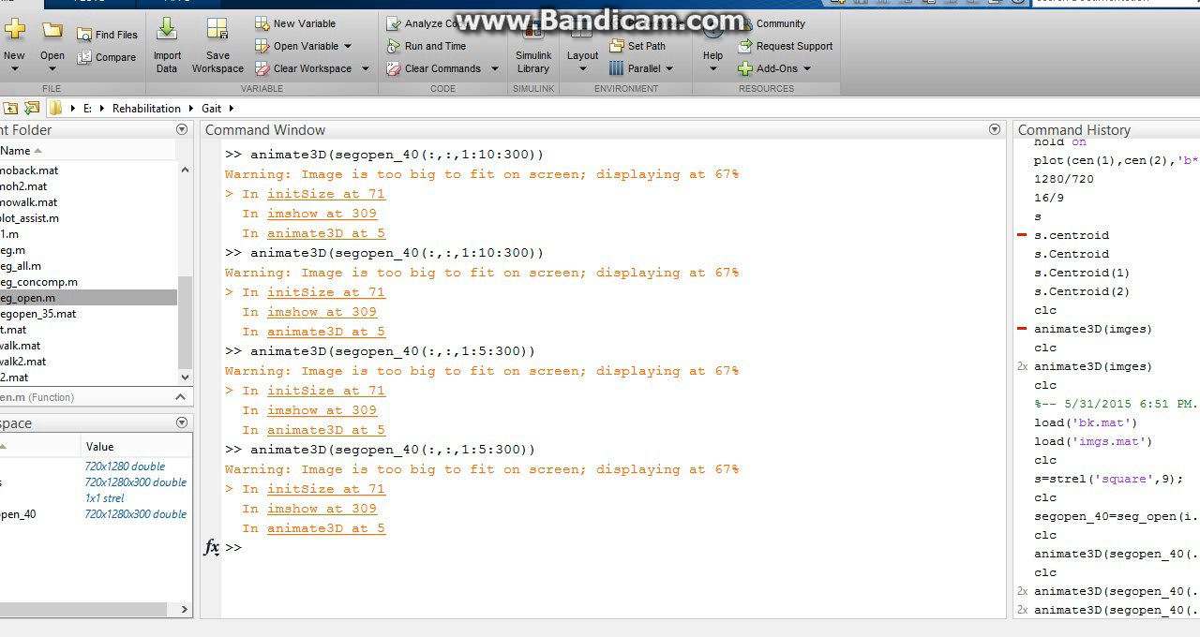
Features to Detect Fall

Slide 28
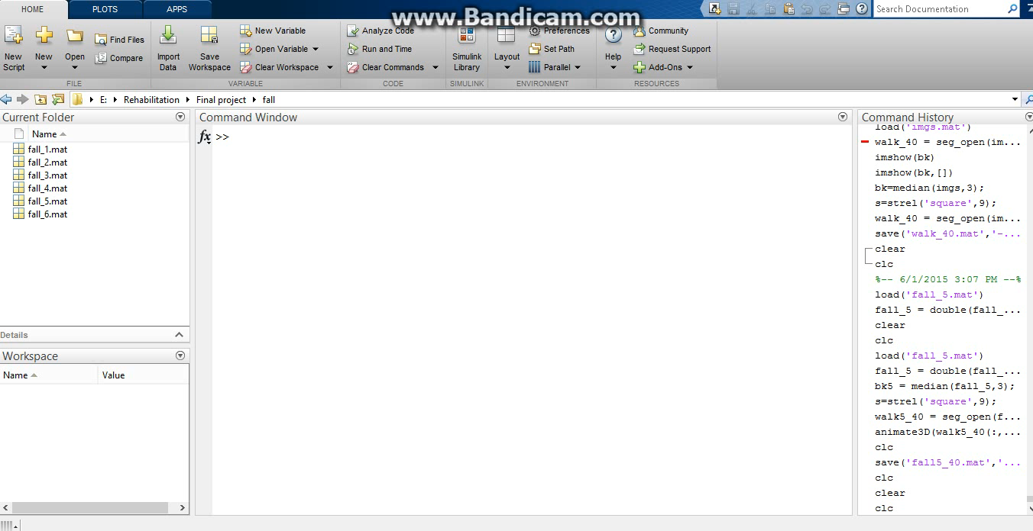
Features to Detect Fall

Slide 29
Classification

Slide 30
Classification
In order to detect fall we need to classify our data into 2 groups: fall or not fall.
We used SVM (support vector machine) classifier in our project.
SVM is a kernel based nonlinear classifier which was introduced by Russian scientist and researcher Vladimir Vapnik.

Slide 31
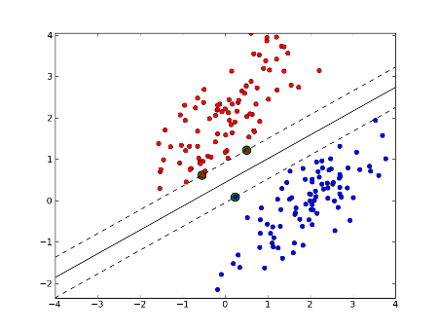
Support Vector Machines

Slide 32
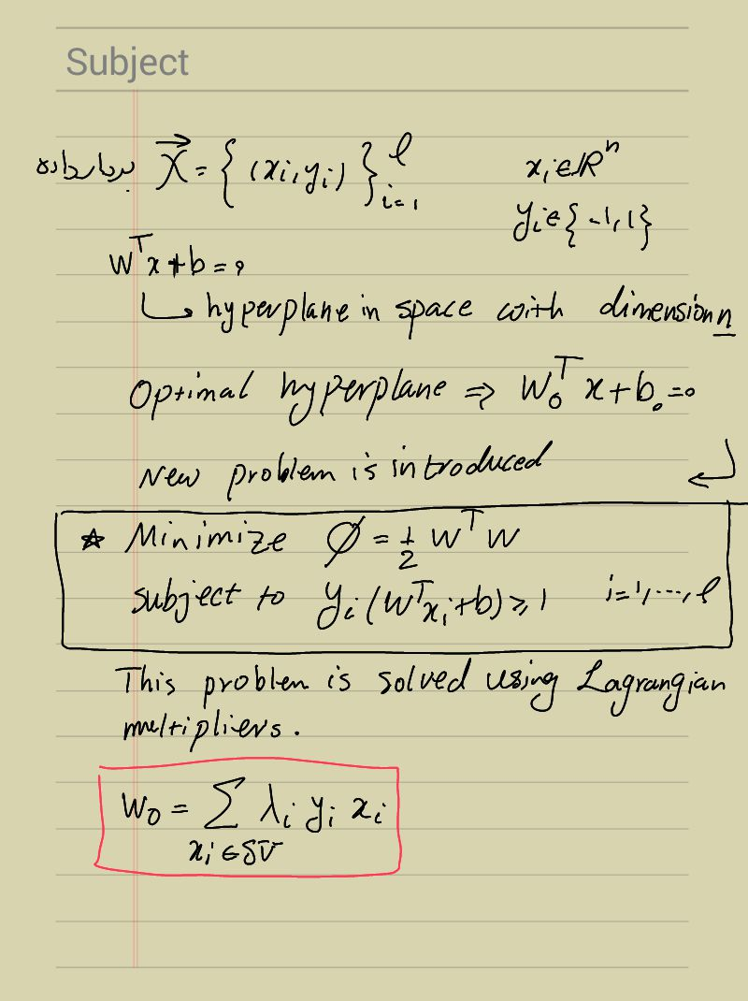
Support Vector Machines

Slide 33
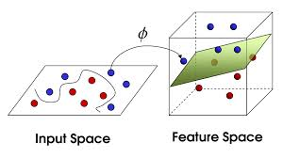
Support Vector Machines

Slide 34
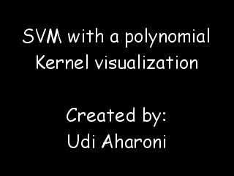
Unfold feature space

Slide 35
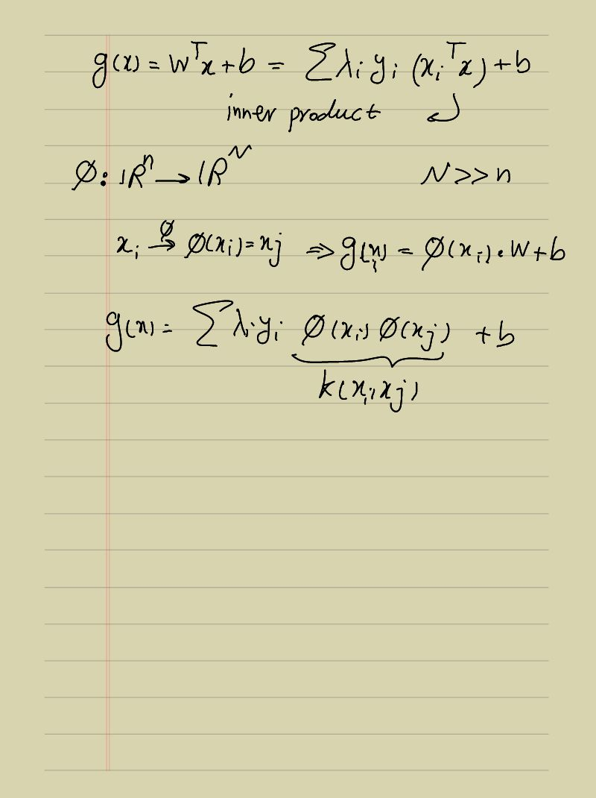
Kernel method

Slide 36
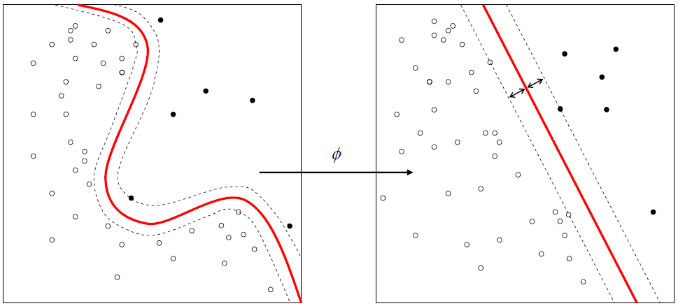
Kernel method

Slide 38
References
Kristian Haga Karstensan,“Silhouette extraction using Graphic’s Processing Unit”.
Mark S. Nixon, Alberto S. Aguado,“Feature Extraction and Image Processing for Computer Vision”, Third edition, pp. 435-470.
Richard O.Duda, Peter E.Hart, David G.Stork.”Pattern Classification” , Second edition.
Erik E.Stone.”Fall Detection In Homes of Adults Using the Microsoft Kinect”

